Slide 1

Your soft skills, your power skills

Slide 2

Well rounded professionals: hard & soft skills development.
Provide resources to work on your personal skills.

Slide 3


INDEX
Transferable skills
Why is it important to cultivate & be aware of your personal skills?
Examples of soft skills
The CAR method: Talking about your soft skills during an interview.

Slide 4
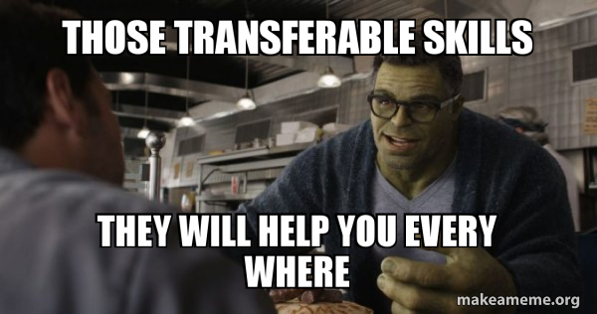

Slide 5

They show you can do the job even if you don’t meet 100% of the requirements.

Slide 6
They show you can do the job even if you don’t meet 100% of the requirements.
You may not have experience in the field, but you have applicable skills.

Slide 7
They show you can do the job even if you don’t meet 100% of the requirements.
You may not have experience in the field, but you have applicable skills.
They give you a wider perspective, a UNIQUE set of skills.

Slide 8

How to identify them?
Make a list of soft & hard skills you’ve used in your personal, professional and academic life.
Read some job postings for the positions of your interest + make a list of the required skills.
Match your skills with the most required ones in the postings.
Highlight them in your resume, LinkedIn, cover letters & interviews!
💡Find more info + tips here.

Slide 9
Why is it important to cultivate & be aware of your personal skills?
Notes:
Today’s workplaces are collaborative, relying heavily on soft skills to get things done.
Hard skills are useless without soft skills to back up their task-related knowledge.
The future of work lies in soft skills; these human characteristics can’t be replicated or replaced by automation or artificial intelligence (AI).
Soft skills are more difficult to learn and therefore more valuable.
Soft skills are often part of our own personality. Each one of us is unique in the way we look at life, the way we behave with others, etc. These are our personal skills, embedded into us!
We acquire new soft skills and get better at others as we go through life experiences - not only professional.
According to Oxford - soft skills are the attributes that help someone to interact well with others
And so in today’s world, where companies are so collaborative, owning good soft skills can only benefit the companies’ best interests to work more efficiently, harmoniously and achieve its business goals.
Moreover, according to a report by Career Builder, 77% of employers think that soft skills are equally important as hard skills! So let’s deep dive into them!

Slide 10



Why is it important to cultivate & be aware of your personal skills?
Can’t be replaced by AI
Collaborative workplaces
More difficult to learn, more valuable

Slide 11


Interpersonal skills
Intrapersonal skills

Slide 12
Some personal skills examples

Slide 13


Slide 14
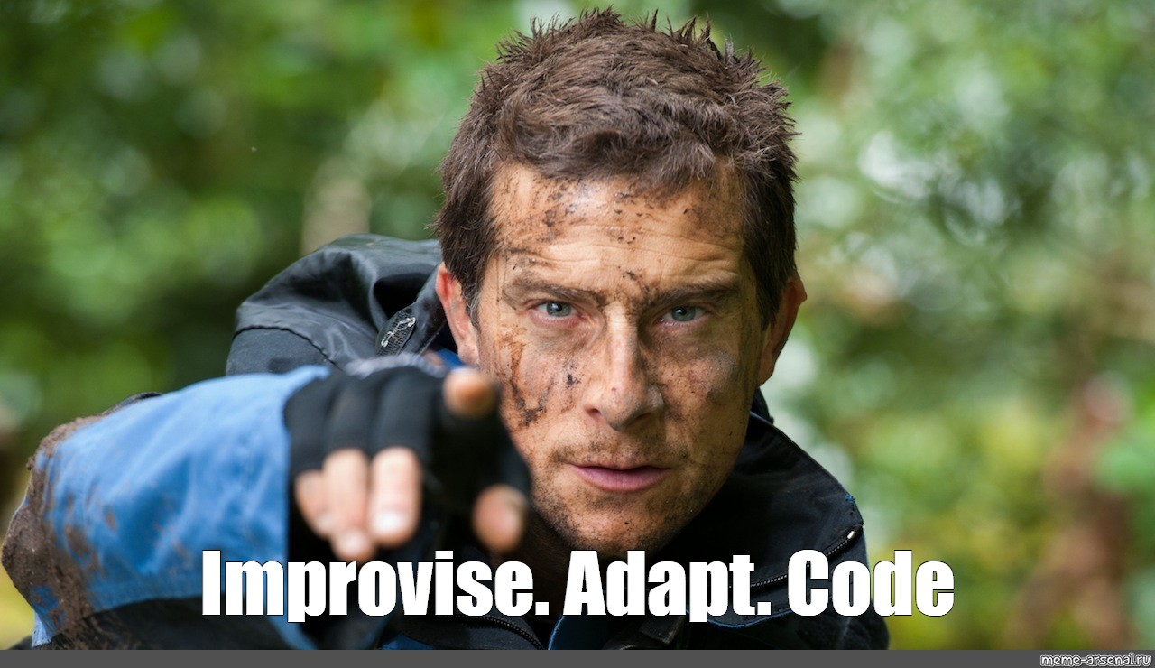

Slide 15
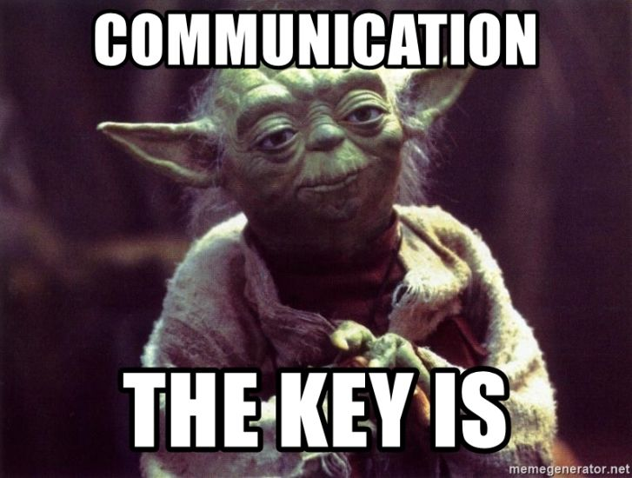

Slide 16


Slide 17

How to train/nurture your soft skills?
Through an online course.
Journaling: identify your emotions, their triggers, your reactions and how could you react better next time you face the same situation.
Recognize behaviours, thoughts and emotional patterns.
Sign up to an onsite course/group (e.g.: sports, theater), expose yourself to relationships, teamwork and feedback.
Ask for feedback from your colleagues, friends, family or mentors.
Psychotherapy.
Observe the behaviour of people you admire, ask them how they became the way they are and apply those advices.

Slide 18
Talking about soft skills in an interview

Slide 19

Prepare for these questions…
How do you manage stress?
Tell me about a time when you had a conflict with a client.
What are your 3 most valuable strengths?
How do you handle tight deadlines?
How do you handle important decisions?

Slide 20

Use the CAR method to answer them

Slide 21
An example…
Challenge
In my last role as junior data analyst, my team was short-staffed for a while and facing significant project delays. It was causing stress for my team and affecting morale.
Action
I suggested to my manager to schedule weekly meetings with account managers to discuss our team’s bandwidth and share progress updates.
Result
By improving communication between teams, we started to set better expectations and were able to re-prioritize the team’s to-do list.

Slide 22

What are your personal skills?
Make a list of 20 qualities you have as a person (interpersonal and intrapersonal). No matter if some of them seem to be repetitive, just write any ideas that come to your mind.
Categorize those qualities: group those similar qualities and name them using the list based on the LinkedIn’s soft skills list.
Choose up to 5 soft skills you would like to highlight on your job applications: LinkedIn and interviews. THESE ARE YOUR CORE SKILLS/TALENTS.
Think about some real life experiences you lived in the past where you can reflect those skills.
Use the CAR method to structure your answers to the behavioural questions.

Slide 23


